Slide 1

Web Server and Application Server

Slide 2
8 Types of Server
File Server
Print Server
Web Server
Application Server
Mail Server
Database Server
Proxy Server
Collaboration Server

Slide 3
Web Server
A computer system that hosts websites
Runs web server software
Apache HTTP server
Internet Informative Services
Lighttpd
Sun Java System web server
Jigsaw server

Slide 4
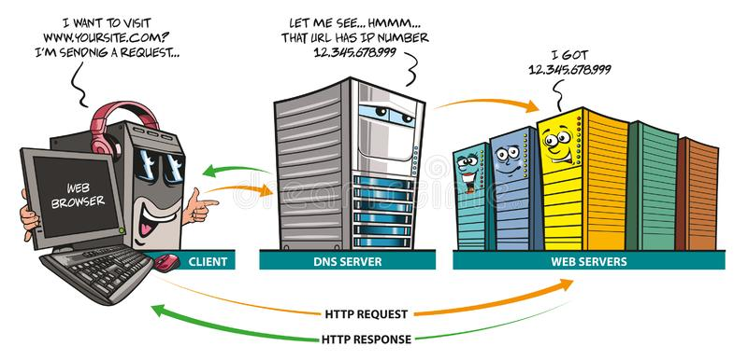
How web server works?

Slide 5
Application Server
A server specifically designed to run applications
Application server platforms
J2EE
Glassfish
Apache Tomcat

Slide 6
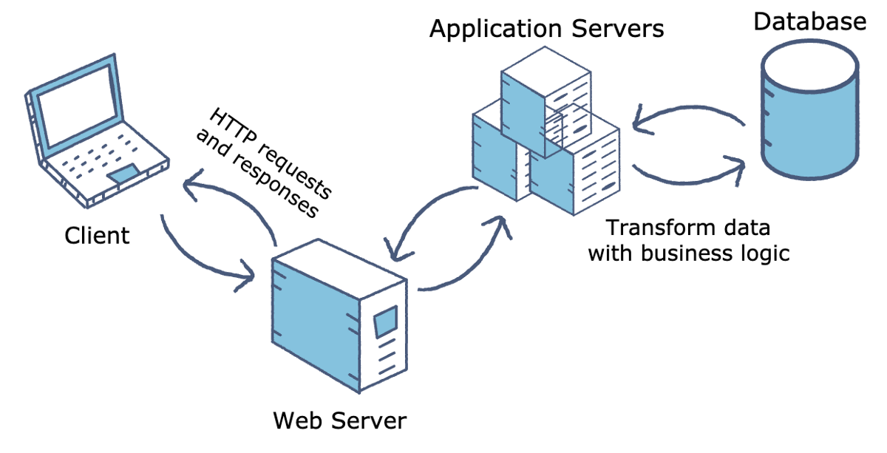
How application server works?

Slide 7
Thank You for Your Attention

